Slide 1
todo Management System
Mini Capstone Project

Slide 2
Project Overview
Goal:
Manage personal tasks efficiently
Add, view, complete, delete tasks
Simple UI for users
Technologies:
Python
SQLite (database)
Streamlit (UI)

Slide 3
Project Structures
TODO_management_system/ │ ├── app.py # Streamlit UI ├── database.py # DB connection & table creation ├── task_service.py # Operations for tasks └── README.md

Slide 4
Database
Column | Type | Notes
id | INTEGER | Primary Key, Auto Increment
name | TEXT | Task description
status | TEXT | 'Pending' / 'Completed'

Slide 5
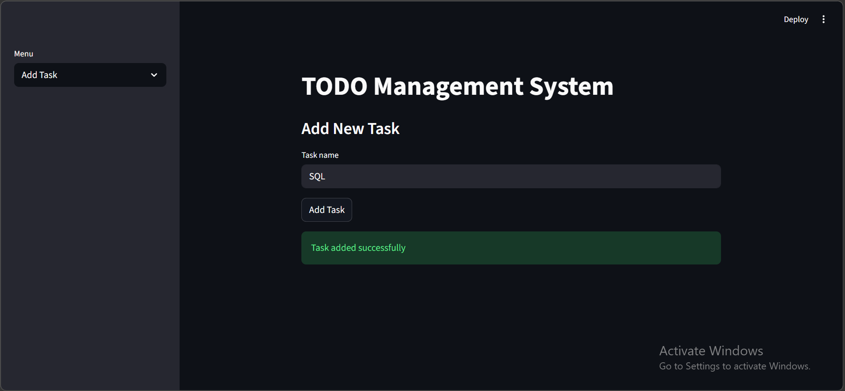
Add Task

Slide 6
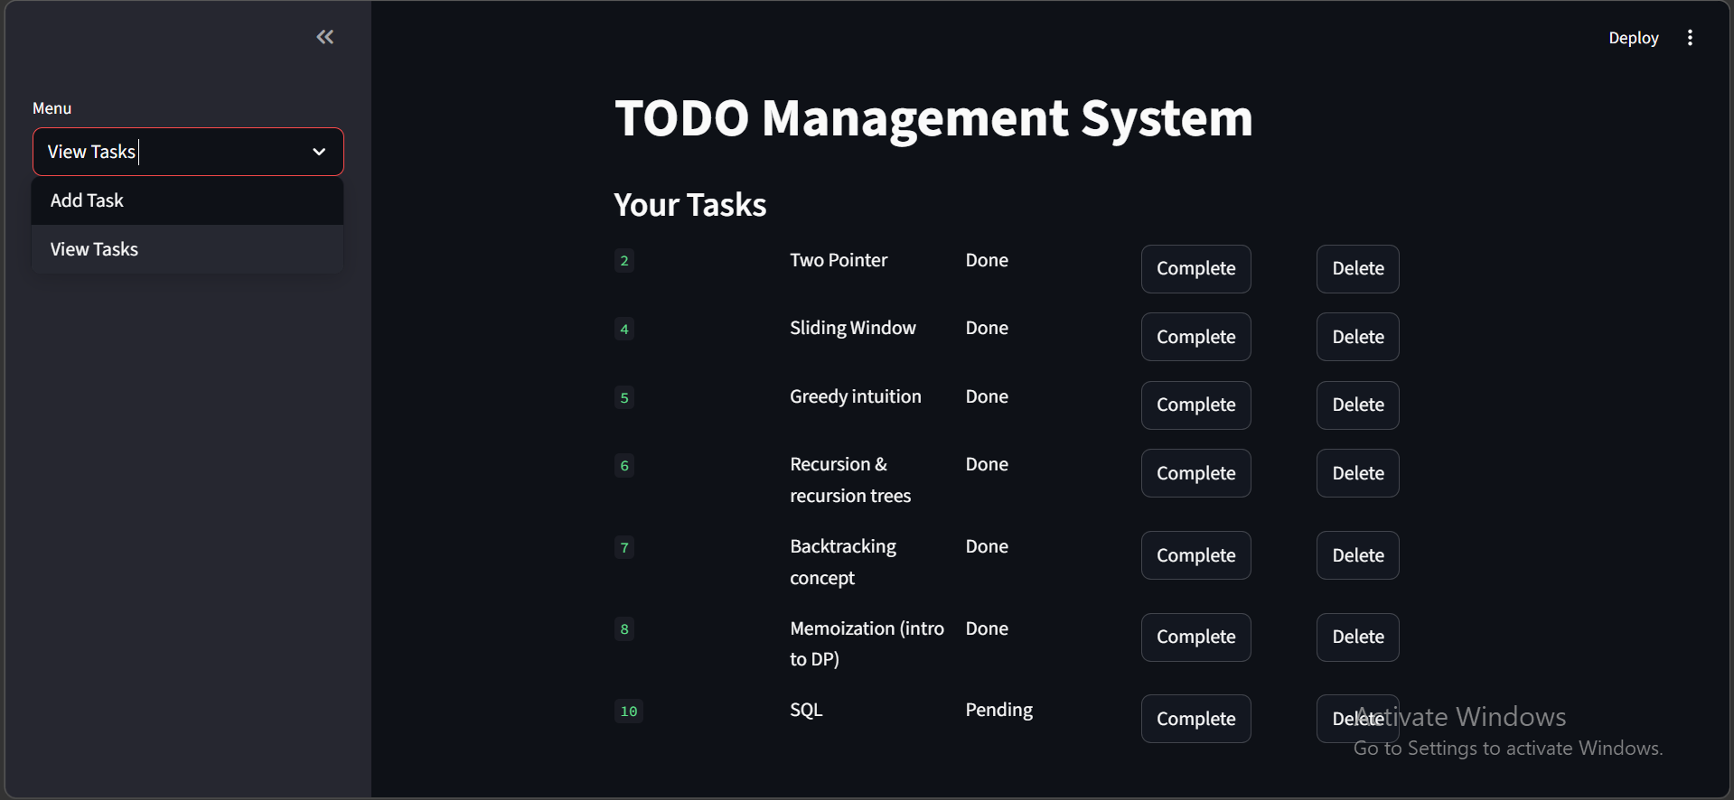
View Task

Slide 7
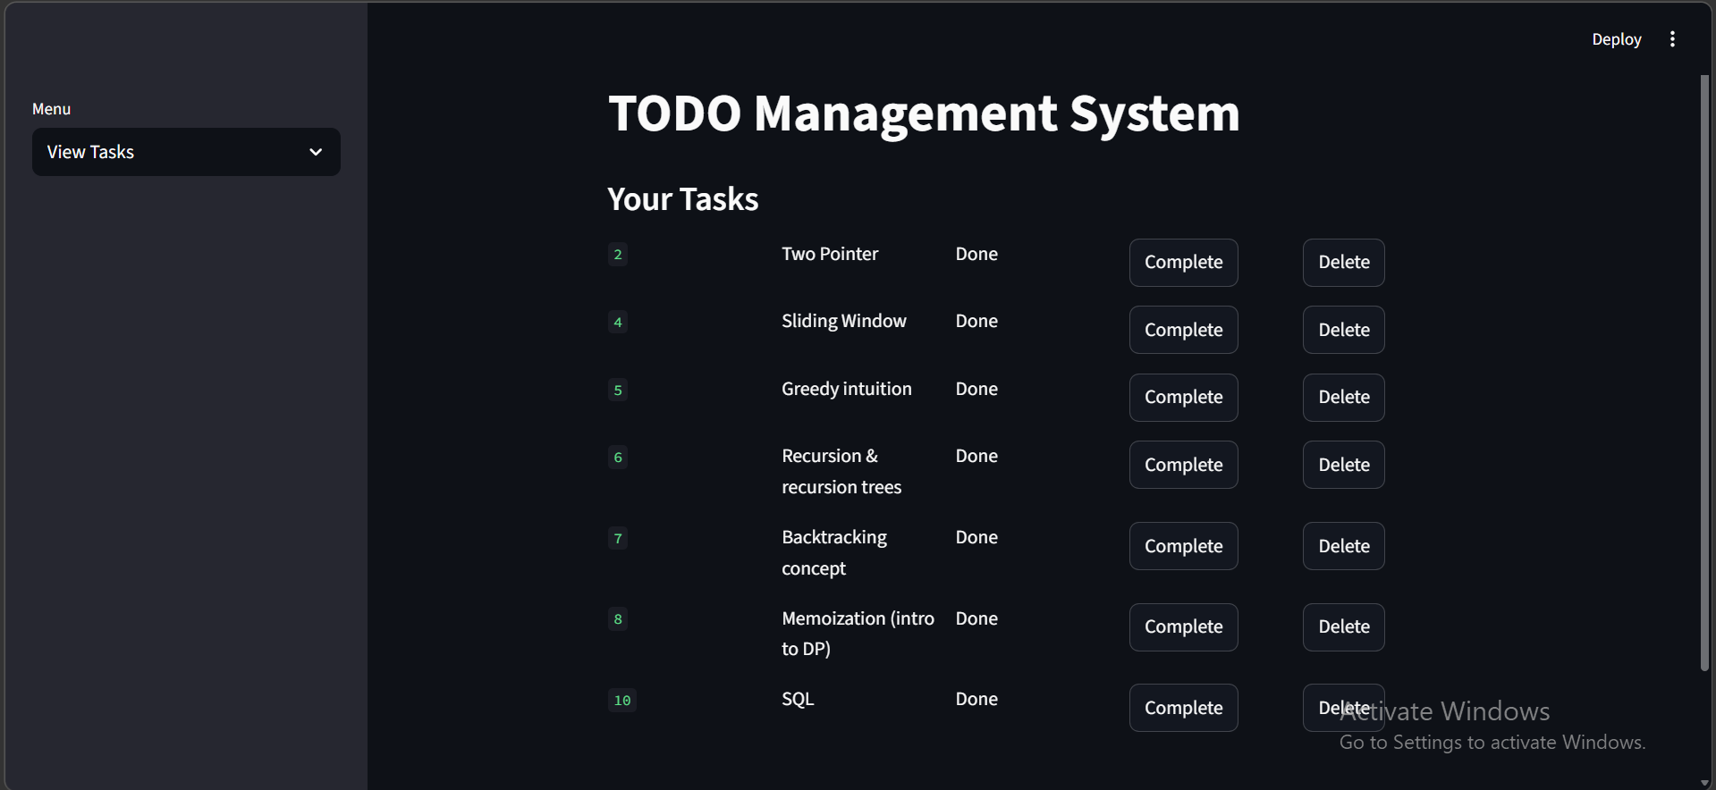
Complete & Delete Intern

Slide 8
Thank you

